Slide 1


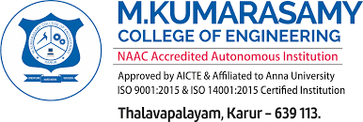
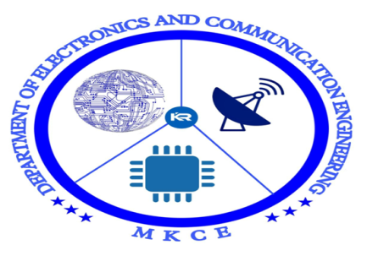
INTRODUCTION TO ANTENNA AND WAVE PROPAGATION
PREPARED BY
SUBASH P (927621BEC213)
TEJ NITHISH S (927621BEC226)
VENKAT RAMAN P (927621BEC238)
YOGESHWARAN S (927621BEC246)
GUIDED BY
Mrs.T.ABIRAMI
(Assistant professor)

Slide 2
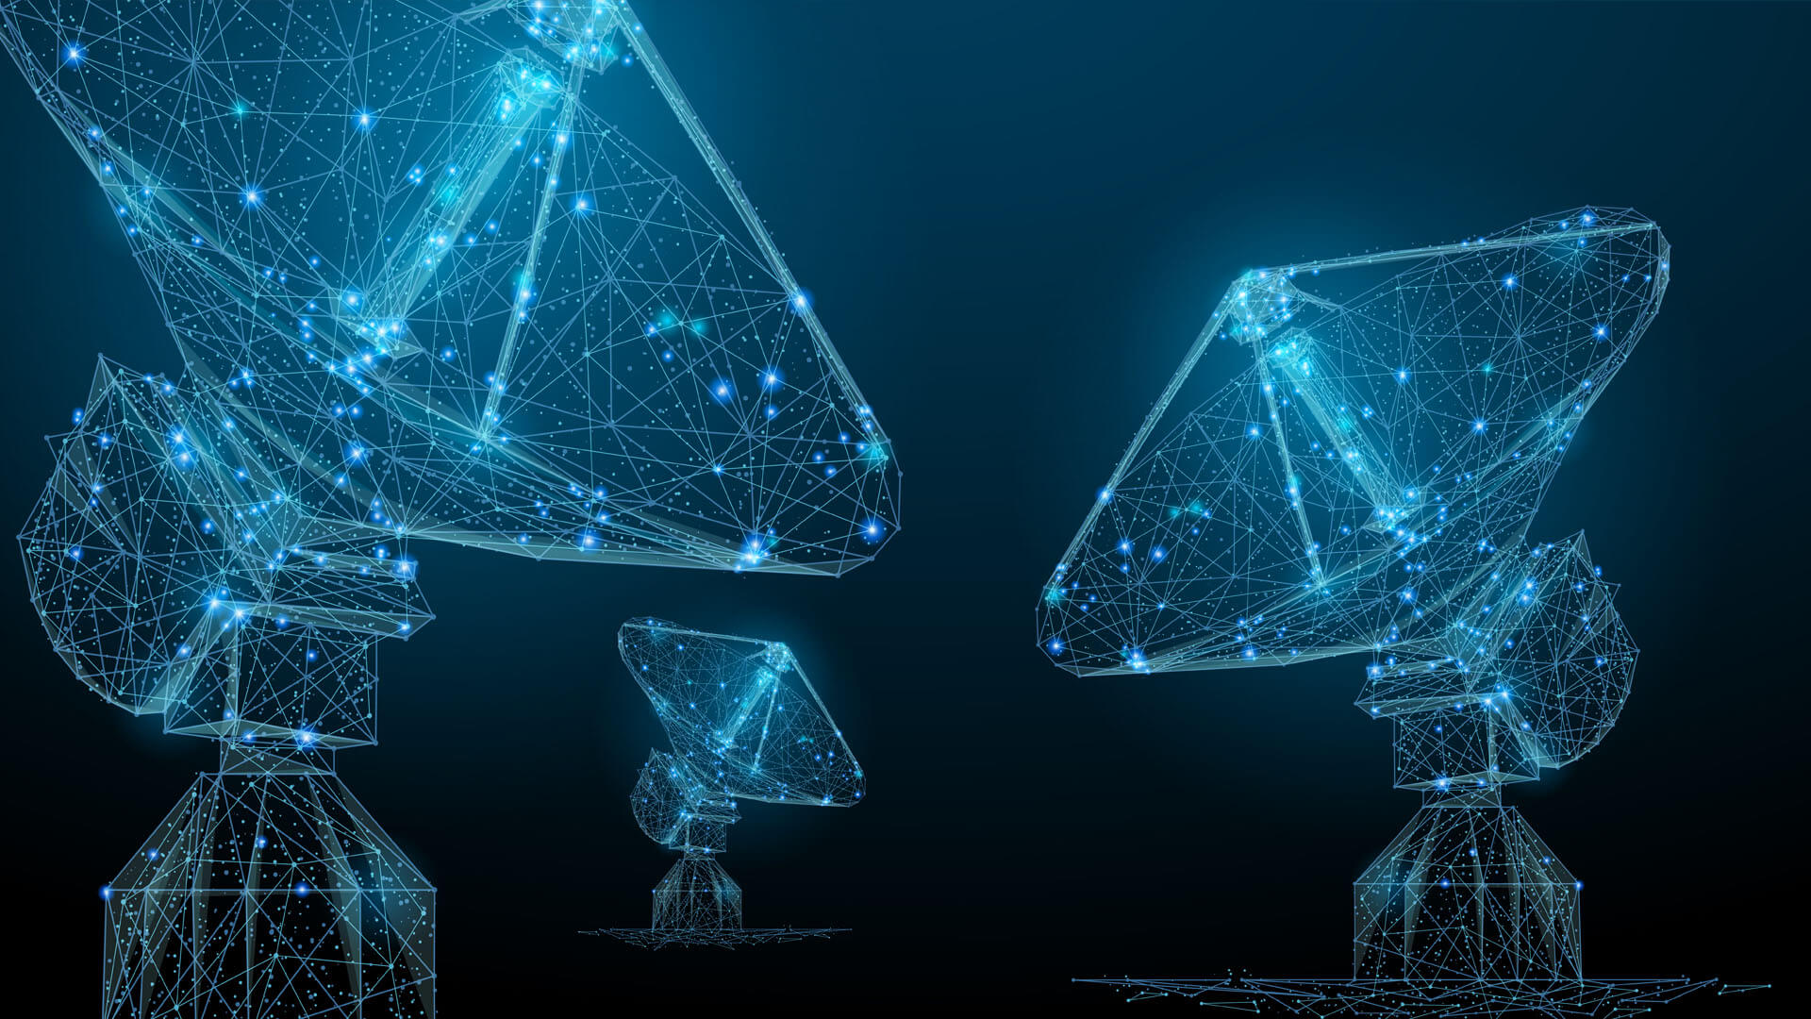
Antenna and Wave Propagation
Notes:
Signal propagation

Slide 3
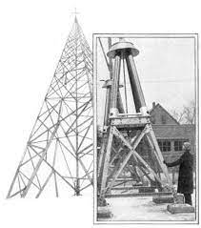
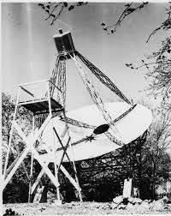
History
The first antennas were built in 1888 by German
physicist Heinrich Hertz.

Slide 4
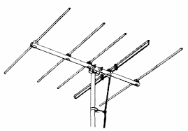
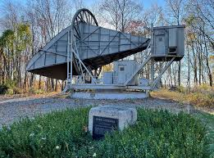
History
1920’s
Yagi - Uda antenna
1930’s
Horn antenna

Slide 5
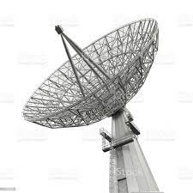
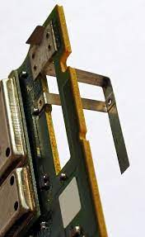
History
1960’s
Dish antenna
1980’s
Planar Inverted-F Antennas (PIFA)

Slide 6
Introduction
An antenna is an electrical conductor or system of conductors
Transmission - radiates electromagnetic energy into space
Reception - collects electromagnetic energy from space
In two-way communication, the same antenna can be used for transmission and reception
Notes:
Technique background on networking. Fundamental background for wireless transmission.
For transmission of signal, radio-frequency electrical energy from the transmitter, is converted into electromagnetic energy by the antenna, and radiated into the surrounding environment (atmosphere, space, water)
For reception of a signal, electromagnetic energy impinging on the antenna is converted into radio-frequency electrical energy and fed into the receiver.
Same frequency is used in both direction.

Slide 7
Introduction
Antennas and wave propagation are closely related concepts in the field of telecommunications and radio communication.
Antennas are tools for sending and receiving
electromagnetic waves, while wave propagation
refers to the way in which these waves travel
through space.

Slide 8
TYPES OF ANTENNAS
Isotropic antenna (idealized)
Radiates power equally in all directions
Dipole antennas
Half-wave dipole antenna (or Hertz antenna)
Quarter-wave vertical antenna (or Marconi antenna)
Notes:
The half-wave dipole consists of two straight collinear conductors of equal length, separated by a small gap. The length of the antenna is one-half the wavelength of the signal that can be transmitted most efficiently.
Automobile radios and portable radios

Slide 9
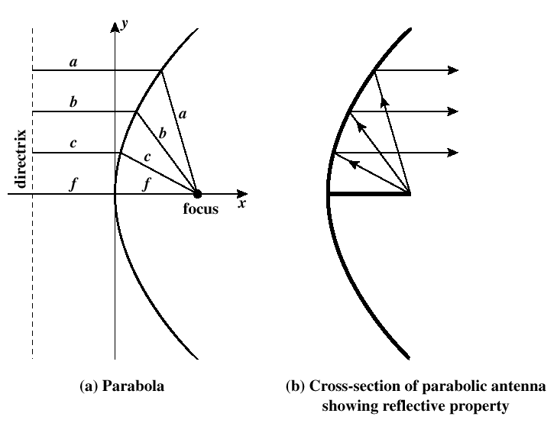
Parabolic Reflective Antenna
Terrestrial microwave and satellite application
Notes:
A parabola is locus of all points equidistant from a fixed line and a fixed point not on the line. Focus, directrix
If a parabola is revolved about its axis, the surface generated is called a paraboloid. A cross section through the paraboloid parallel to its axis forms a parabola a cross section perpendicular to the axis
Automobile headlights, telescopes. Reflecting. Wave bounce back

Slide 10
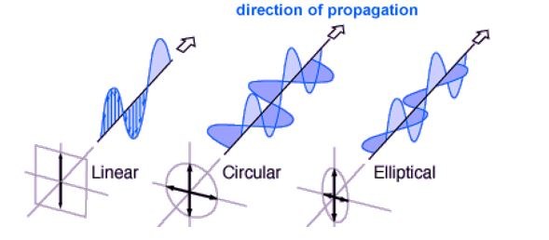
POLARIZATION
The direction of the electromagnetic fields produced by the antenna as energy radiates away from it.

Slide 11
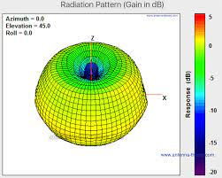
ANTENNA GAIN
Antenna gain measures its ability to direct and receive signals in a particular direction.

Slide 12
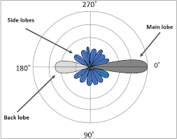
RADIATION PATTERN
Radiation pattern shows the distribution of signal strength around the antenna.

Slide 13
Propagation Modes
Ground-wave propagation
Sky-wave propagation
Line-of-sight propagation
Notes:
A signal radiated from an antenna travels along one of three routes

Slide 14
Ground Wave Propagation
Follows contour of the earth
Can Propagate considerable distances
Frequencies up to 2 MHz
Example
AM radio

Slide 15
Sky Wave Propagation
Signal reflected from ionized layer of atmosphere back down to earth
Signal can travel a number of hops, back and forth between ionosphere and earth’s surface
Reflection effect caused by refraction
Examples
Amateur radio
CB radio

Slide 16
Line-of-Sight Propagation
Transmitting and receiving antennas must be within line of sight
Satellite communication – signal above 30 MHz not reflected by ionosphere
Ground communication – antennas within effective line of sight of each other due to refraction
Refraction – bending of microwaves by the atmosphere
Velocity of electromagnetic wave is a function of the density of the medium
When wave changes medium, speed changes
Wave bends at the boundary between mediums
Notes:
A brief discussion about refraction is warranted. Such as light or radio wave travels at approximately . Vacuum
If moving from a less dense to a more dense medium, the wave will bend toward the more dense medium. Shorter and bent
Continuous, gradual bending

Slide 17
LOS Wireless Transmission Impairments
Attenuation and attenuation distortion
Free space loss
Noise
Atmospheric absorption
Multipath
Refraction
Notes:
With any communications system, the signal that is received will differ from the signal that is transmitted, due to different transmission impairments. For digital signal, bit errors are introduced. Vice verse

Slide 18
Error Compensation Mechanisms
Forward error correction
Adaptive equalization
Diversity techniques
Notes:
The effects to compensate for the errors and distortions introduced by multipath fading fall into three general categories

Slide 19
Forward Error Correction
Transmitter adds error-correcting code to data block
Code is a function of the data bits
Receiver calculates error-correcting code from incoming data bits
If calculated code matches incoming code, no error occurred
If error-correcting codes don’t match, receiver attempts to determine bits in error and correct
Notes:
Digital transmission. A receiver, using only information contained in the incoming digital transmission, correct bit errors in the data. The receiver may detect the presence of errors and then sends a request back the transmitter to retransmit the data in error. Practical wireless applications. Satellite communication, the amount of delays involved. Mobile communications. The bit errors are so high.
A coding algorithm. The threshold . The length of code and the nature of algorithm.
2-3

Slide 20
Adaptive Equalization
Can be applied to transmissions that carry analog or digital information
Analog voice or video
Digital data, digitized voice or video
Used to combat intersymbol interference
Involves gathering dispersed symbol energy back into its original time interval
Techniques
Lumped analog circuits
Sophisticated digital signal processing algorithms
Notes:
Linear equalizer circuit. For each output symbol, the input signal is sampled at five uniformly spaced intervals of time, separated by a delay T. the samples are individually weighted by the coefficients Ci, and sumed to the output symbol. Adaptive adjusted training sequence.

Slide 21
Diversity Techniques
Diversity is based on the fact that individual channels experience independent fading events
Space diversity – techniques involving physical transmission path
Frequency diversity – techniques where the signal is spread out over a larger frequency bandwidth or carried on multiple frequency carriers
Time diversity – techniques aimed at spreading the data out over time
Notes:
We provide multiple logical channels in some sense between transmitter and receiver and sending part of the signal over each channel. The technique does not eliminate errors but it does reduce the error rate, because we have spread the transmission out to avoid being subjected to the highest error rate that might occur.
Space: multiple nearby antennas may be used to receive the message, then reconstruct the most likely transmitted signal. Multiple directional antennas, each oriented to a different reception angle with the incoming signals, then combined to reconstruct the transmitted signal.
So that a noise burst affects fewer bits. If a mobile host is moving slowly, it may remain in a region of a high level of fading for a relatively long interval. Even powerful error correction codes may be unable to cope with this error. If the data is transmitted in a TDM, in multiple users share the same physical channel by the use of time slots. interleaving

Slide 22
Conclusion
Antenna wave propagation is crucial for wireless communication.
Understanding the various propagation mechanisms and antenna types is essential for optimizing communication systems.

